Slide 1
Stock Market Analysis
Rolls John
Company : ITC
Designation : Data Engineer

Slide 2
Contents
Introduction
Business Value
Problem Statement
Pipeline
Methodology
Findings
Results

Slide 3
Introduction
What is Stock Market?
Investors buy and sell shares of companies
Marketplaces where securities like stocks and bonds are bought and sold
How the Stock Market works?
A company divides itself into several shares and sells some of those shares to the public at a price per share
It helps companies to raise necessary capital from investors.

Slide 4
Business Value
Understanding the Market values
Dynamic nature of Market values
Understand the growth rate of a company
Help investors to take right decisions

Slide 5
Problem Statement
Objectives
Retrieve all required data from source-Extraction
Transformation-Data cleaning and aggregation that prepares it for analysis
Loading-Extracted and transformed data is loaded into the end target

Slide 6













Pipeline
Data Visualization
Data Streaming
Custer creation
Data Storage
Data Extraction
Start Process
Curated data to hadoop cluster and Hive
(Data Warehouse)
Raw data from hdfs storage

Slide 7
Methodology
Data Ingestion & Data Collection
Prioritizing data sources, validating individual files, and routing data streams to the correct destination
Collect data from datahub
Store csv file(company details and trading details of the company) stored in the hdfs
Streaming data from the directory
Input of the streamed data is json files and static data is csv files

Slide 8
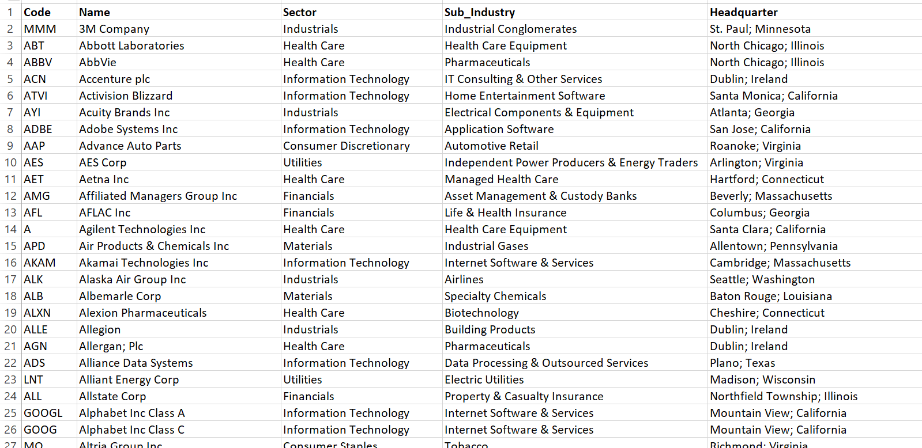
Input csv files

Slide 9
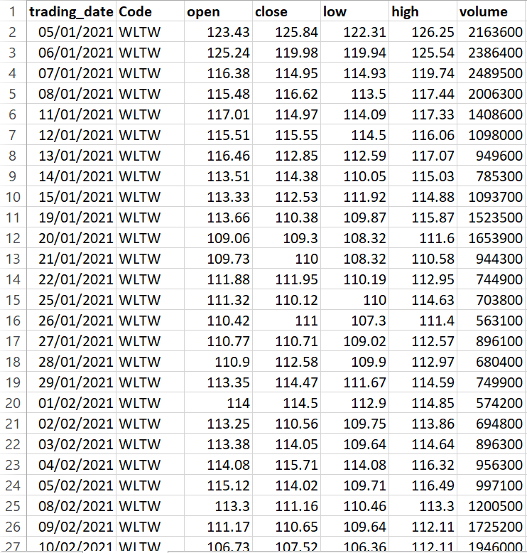

Slide 10
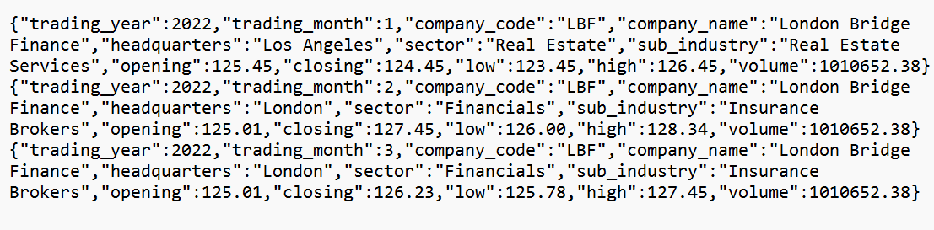
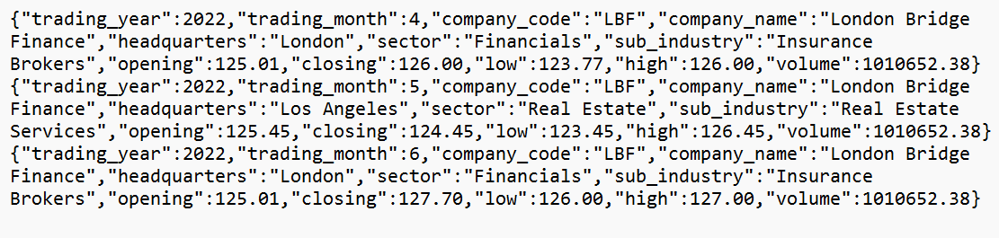
Input Json files for data streaming

Slide 11
Data Processing
Classifying data flow, and acting as the first point of analytic
Using scala language with spark
Data Query
Using Spark SQL for analytics query transformations
Data Storage
Using HDFS and Hive table

Slide 12
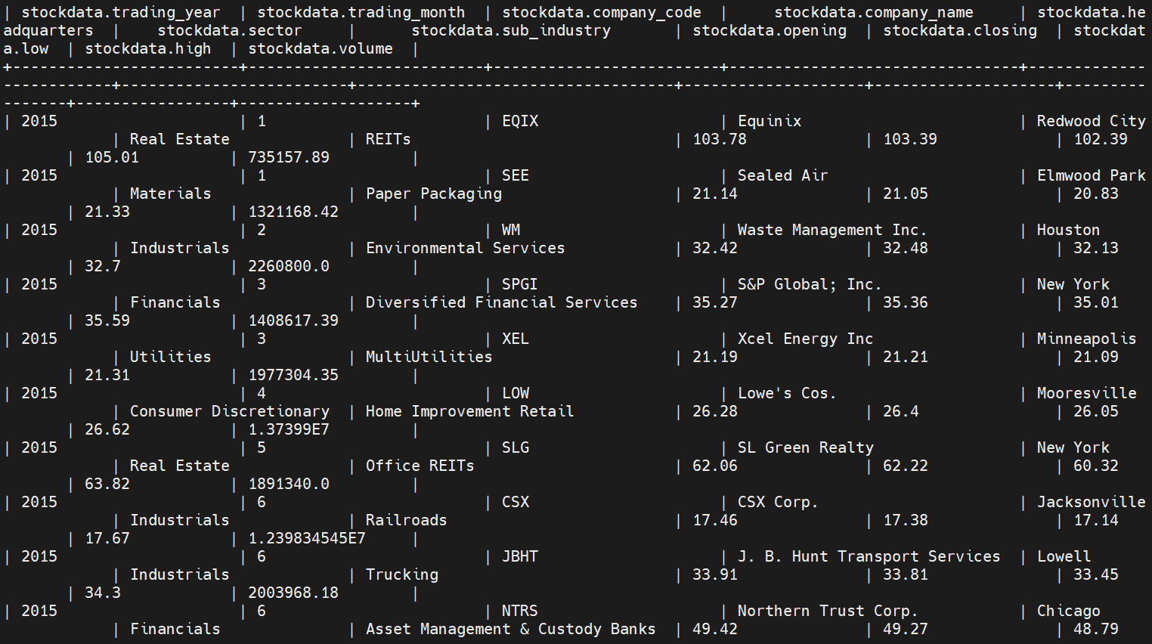

Slide 13
Data Visualization
This layer is dedicated to the visualization of large amounts of data
Vegas is used for visualizing the data
Deployment
Github and Jenkins
create workflows that automatically build, test, publish, release, and deploy code

Slide 14
Findings
Top 10 companies are good for investing
Worst year and growth rate of each sector
Best Performance year and growth rate of each sector

Slide 15
Results

Slide 16
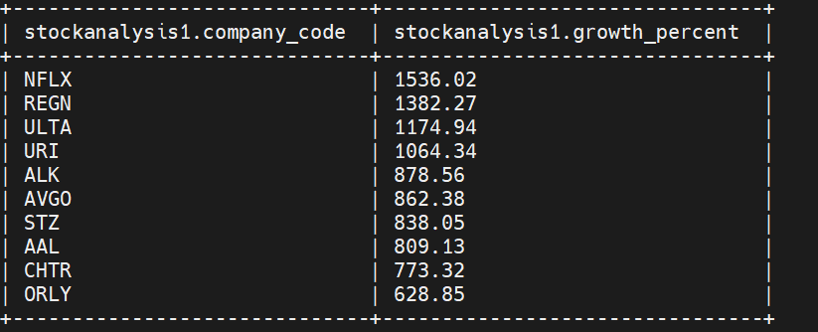
Top 10 companies good for investment

Slide 17
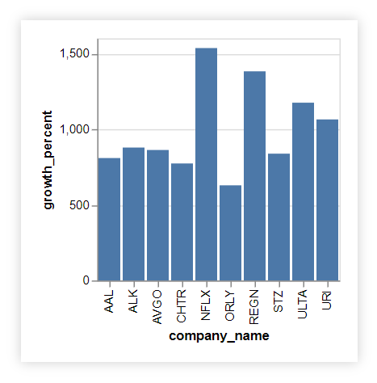
Top 10 companies good for investment

Slide 18
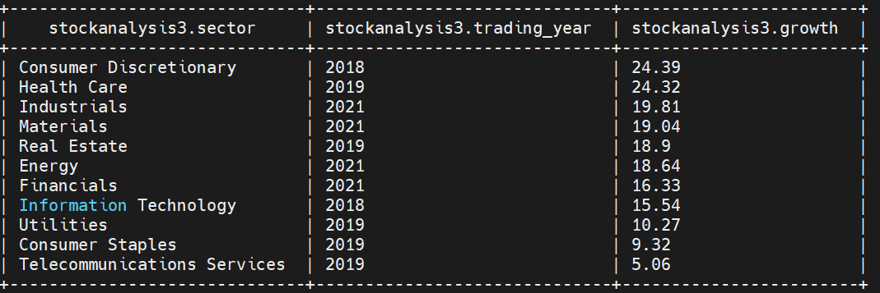
Best performance year for each sector

Slide 19
Best performance year for each sector

Slide 20
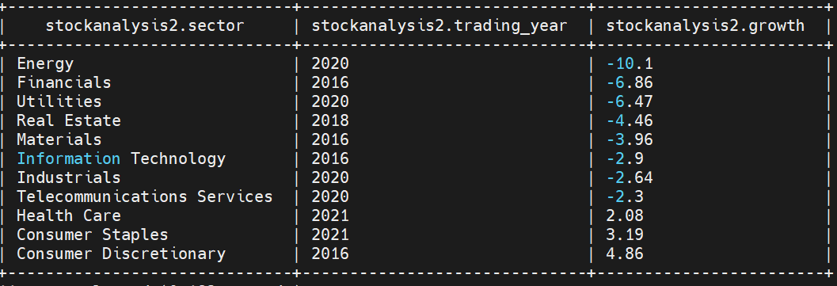
Worst performance of the year with each sector

Slide 21
Worst performance of the year with each sector

Slide 22
Future Work
Analyse more trading factors.
Data streaming from api’s using kafka in realtime
Implement in new technologies i.e., Hbase, data extraction tools etc

Slide 23
THANK YOU

